Slide 1
pic
Experience
Summary
Contact
Education
Skills
About Me
Certifications
Projects

Slide 2
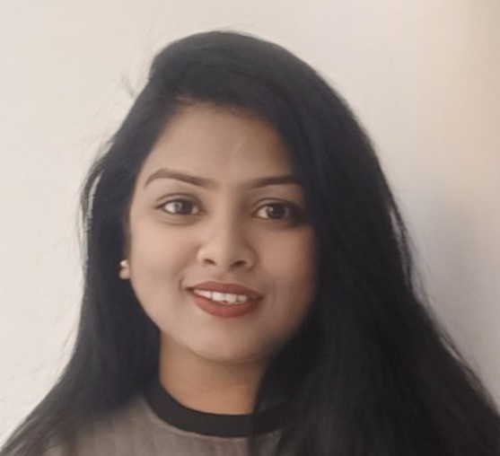





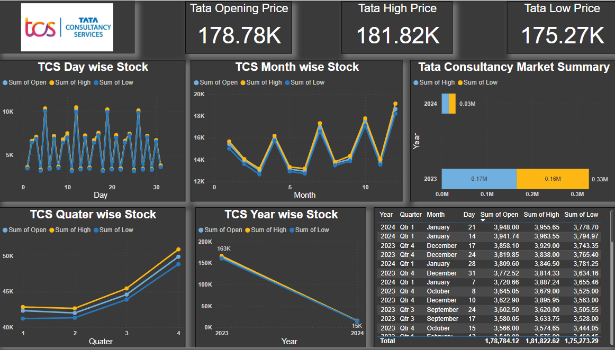
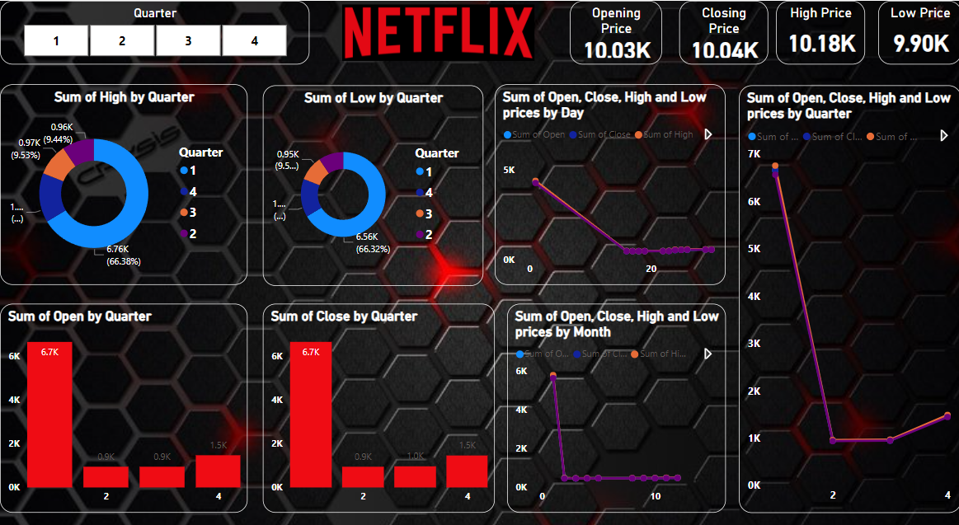
EXPERIENCE
SAHANA
9741877131
dasansahana@gmail.com
EDUCATION
BE: Khaja Banda Nawaz College of Engineering [2016-2021] | 7.01 CGPA
PUC: Sarvagna PU college of Science |65.66%
SSLC: Mahatma Gandhi high School | 75.52%
SKILLS
CAREER OBJECTIVE
Solution-driven Analyst, with experience in multiple verticals and Data analysis, having direct impact on solution-oriented process setting with End-to-End process cycle with strong Data analysis and reporting skills.
CERTIFICATIONS
PROJECT
Proven ability in implementing various metrics driven reports with clear data models in the product and enabling it as a simple tool for the business leads.

